Slide 1
Electronic Instrumentation Section-1, Ppt-2
Analogue Instruments

Slide 2
The analogue instrument can be classified based on the type of the electrical current as:
Direct Current (DC) Analog Instruments (i.e. DC voltmeter and ammeter)
2. Alternating Current (AC) Analog instrument (i.e. AC voltmeter and ammeter)
3. Both DC and AC Instruments. (i.e. Analog multimeter)
The analogue instruments can also be classified based on their function as:
Indicating Instruments
Recording Instruments
Integrating Instruments

Slide 3
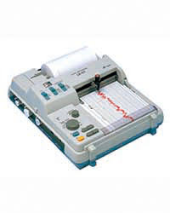
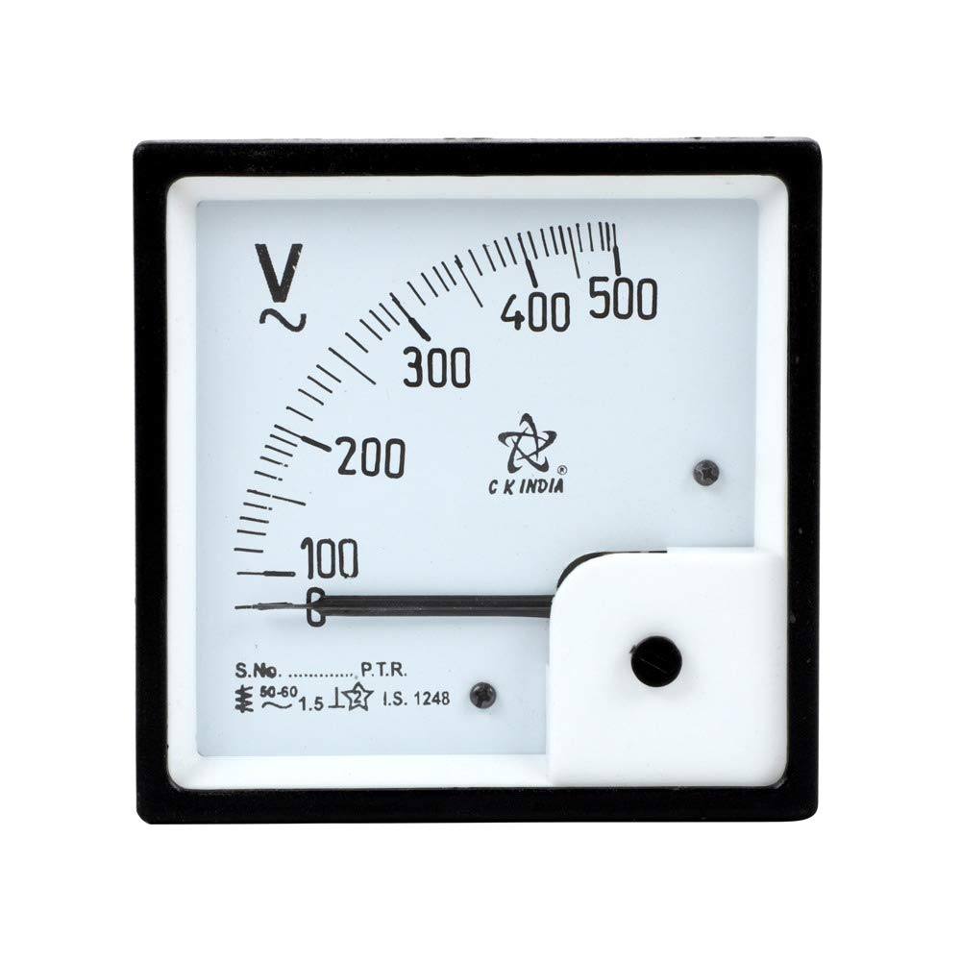
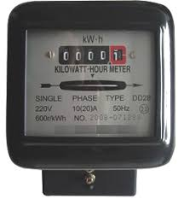
Fig. 1. Indicating Instrument
Fig. 2. Recording Instrument
Fig. 3. Integrating Instrument

Slide 4
Indicating Instruments: These type of instruments indicate the magnitude of a parameter to be measured. It uses the dial and pointer as an indicator.
Example: Ammeter and voltmeter.
Recording Instruments: These type of instrument gives a continuous reading over a specified period. The variations in quantities are recorded on the sheet of paper.
Example: Strip chart recorder, ECG machine
Integrating Instruments: The instrument which measures the summation of the electrical quantity over a given period is known as the integrating instruments.
Example: Energy meter (i.e. energy consumed in kWh)

Slide 5
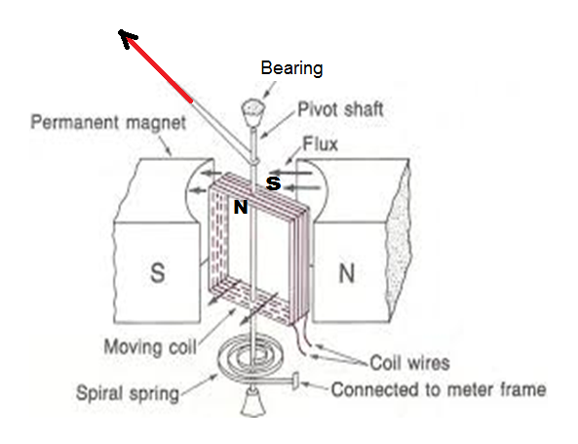
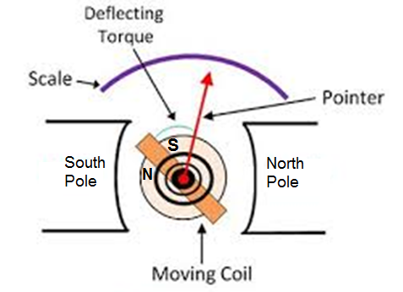
Construction of permanent magnet moving coil (PMMC) galvanometer
Fig. 4.
Fig. 5.
Fleming's left-hand rule: When a current-carrying conductor is placed in an external magnetic field, the conductor experiences a force perpendicular to both the field and to the direction of the current flow.
When electric current through the coil flows, the pointer moves in a clockwise direction, due to the attraction between the opposite magnetic poles of the permanent magnet and the moving coil. More is the coil current more is the attraction force and more is the deflection of the pointer.

Slide 6
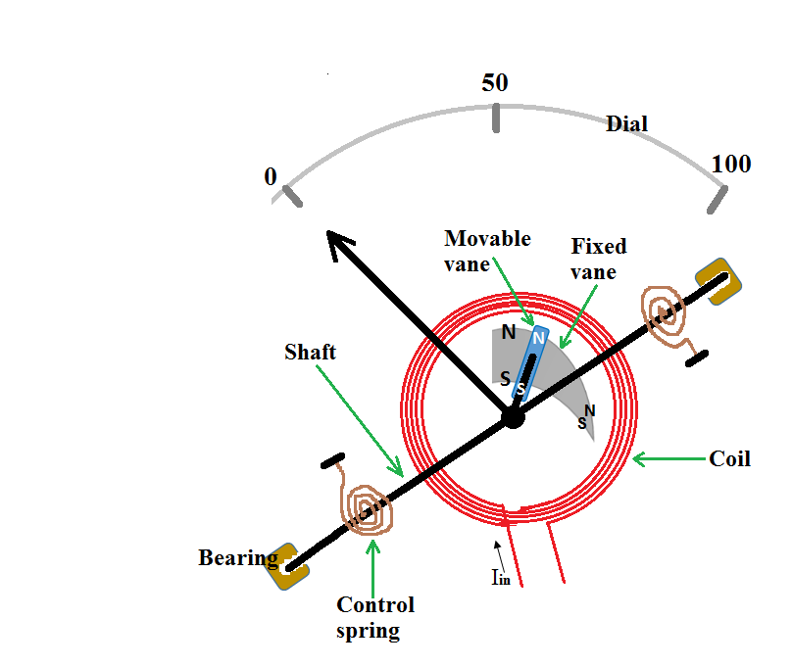
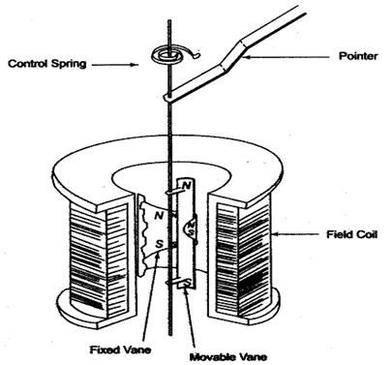
Construction of moving iron type instrument
Fig. 6.
Fig. 7.
Faradays law of electromagnetic induction: A current will be induced in a conductor when it is placed under a changing magnetic field.
Lenz’s law: The direction of the electric current induced due to the changing magnetic field is such that, the magnetic field created by the induced current opposes the changing magnetic field.
Due to AC magnetic field, eddy current is generated in both movable and fixed vanes. As the magnetic field polarity is same the movable vane is repelled by the magnetic field induced in the fixed vane and the pointer moves to clockwise direction (i.e. from the broader side of the fixed vane where magnetic repulsion force is more to the narrow side of the vane where repulsion force is less)

Slide 7
Advantages
The PMMC consumes less power and has great accuracy.
It has a uniformly divided scale and can cover an arc of 270 degrees.
The PMMC has a high torque to weight ratio.
It can be modified as ammeter or voltmeter with suitable resistance.
It has efficient damping characteristics and is not affected by stray magnetic field.
It produces no losses due to hysteresis.
Disadvantage
The moving coil instrument can only be used on D.C supply as the reversal of current produces a reversal of torque on the coil.
It’s very delicate and sometimes uses AC circuit with a rectifier.
It’s costly as compared to moving coil iron instruments.
It may show an error due to loss of magnetism of permanent magnet.

Slide 8
What are the different reasons that cause an error in PMMC?
Temperature effect: Error in the reading of the PMMC may cause due to change in the temperature which will affect the resistance of the moving coil. The temperature coefficients of the value of the coefficient of copper wire in moving coil are 0.04 per degree Celsius rise in temperature. Since the coil has a lower temperature coefficient, it will have a faster rate of temperature rises which will result in increase in the resistance causing an error
Spring material and age: The other factor which may lead to error in the PMMC reading is the quality and contortion of the spring. Old aging spring will not allow the pointer to show the correct reading making an error.
Ageing of Magnet: Along with the age, the effect of heat and vibration will reduce the magnetic effect of the permanent magnet which will produce an error in the reading.

Slide 9
Let, l, d – the length of respective vertical and horizontal side of the coil in the meter.
N – number of turns in the coil,
B – Flux density in the air gap, wb/m²
i – current through moving coil in Ampere

Slide 10





.
The G is called the displacement constant of the galvanometer.

Slide 11
Moving Coil (M.C.) Instrument | Moving Iron (M.I.) Instrument
More accurate | Less accurate
Costly | Cheaper
Uniform scale (linear) | Non-uniform scale (non – linear)
Sensitive in construction | Robust in construction
Low power consumption | More power consumption
Deflection in moving coil instrument is proportional to current i.e. θ ∝ I. | Deflection in moving iron instrument is proportional to square of the current i.e. θ ∝ I².
It is used for DC measurements. | It is generally used for AC measurements.

Slide 12
Analog Instrument | Digital Instrument
Position of pointer on a dial/scale indicates the value of the parameter. If exact reading is required operator takes more time to guess | Direct value is displayed on the digital display Very fast in taking readings
Possibility of human error exists | Possibility of human error does not exist
Accuracy up to 0.25% is possible | Accuracy up to +0.005% or greater is possible
Very small change cannot be detected | Very small change can be detected
Moving part involved | No moving parts
Loading effect on the input is present | Negligible loading effect
Simple, direct reading type, can perform in unfavorable conditions | Involves electronics, proper environmental conditions are required (due to operating temperature limit)
By seeing needle movement (Rate of change of a parameter is easy to visualize, i.e. speedometer) | No knowledge of change. (Rate of change of a parameter is difficult to visualize, i.e. DMM)
No requirement of auxiliary power | Auxiliary power source is required.

Slide 13
Thank you

